Slide 1
House Price Prediction

Slide 2
Modules Description
Collection of Dataset
It is the first step in machine learning techniques, data samples are collected from kaggle website. The quantity and quality of the data determine the better prediction.
Data Preprocessing
It is a process of transforming the raw, complex data into systematic understandable knowledge. It involves the process of finding out missing and redundant data in the dataset. Thus, this brings uniformity in the dataset. However in our dataset, there was no missing values found meaning that every record was constituted its corresponding feature values.

Slide 3
Feature Extraction
The feature Extraction technique gives us new features which are a linear combination of the existing features. The new set of features will have different values as compared to the original feature values. The main aim is that fewer features will be required to capture the same information.

Slide 4
Linear Regression
Regression is concerned with specifying the relationship between a single numeric dependent variable (the value to be predicted) and one or more numeric independent variables (the predictors). As the name implies the dependent variable depends upon the value of the independent variable or variables. The simplest forms of regression assume that the relationship between the independent and dependent variables follows a straight line. The origin of the term "regression" to describe the process of fitting lines to data is rooted.

Slide 5
Random Forest
Random Forest is a popular machine learning algorithm that belongs to the supervised learning technique. It can be used for both Classification and Regression problems in ML. It is based on the concept of ensemble learning, which is a process of combining multiple classifiers to solve a complex problem and to improve the performance of the model.Random Forest is a classifier that contains a number of decision trees on various subsets of the given dataset and takes the average to improve the predictive accuracy of that dataset.

Slide 6
How does Random Forest algorithm work?
Random Forest works in two-phase first is to create the random forest by combining N decision tree, and second is to make predictions for each tree created in the first phase.
The Working process can be explained in the below steps and diagram:
Step-1: Select random K data points from the training set.
Step-2: Build the decision trees associated with the selected data points (Subsets).
Step-3: Choose the number N for decision trees that you want to build.
Step-4: Repeat Step 1 & 2.
Step-5: For new data points, find the predictions of each decision tree, and assign the new data points to the category that wins the majority votes.

Slide 7
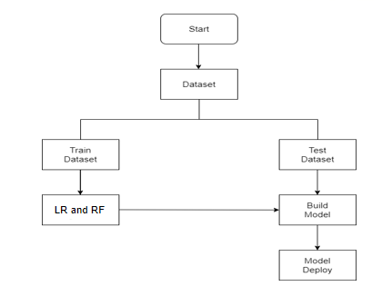
Flow Chart

Slide 8
Screenshot

Slide 9
Conclusion
In this project, we have used Random forest and Linear Regression algorithm applied for house price prediction. This algorithm is to predict prices of new properties that are going to be listed by taking some input variables and predicting the correct and justified price.This was an incredibly learning experience iterating on building a predictive Sale Price model. In Future Using different methods that match the time-series data will be used in the research to obtain smaller error prediction values and using more data to get the better result.

Slide 10
Thank You

